Slide 1
IMPLEMENTATION OF MICRO PROGRAMMED CONTROL UNIT

Slide 2
INTRODUCTION:
Microprogram consists of microinstructions which are nothing but the strings of 0's and 1's. In a particular instance, we read the contents of one location of microprogram memory, which is nothing but a microinstruction.
Each output line ( data line ) of microprogram memory corresponds to one control signal. If the contents of the memory cell is 0, it indicates that the signal is not generated and if the contents of memory cell is 1, it indicates to generate that control signal at that instant of time.

Slide 3
CONTINUED…
Control Word (CW) : Control word is defined as a word whose individual bits represent the various control signal. Therefore each of the control steps in the control sequence of an instruction defines a unique combination of 0s and 1s in the CW.
A sequence of control words (CWs) corresponding to the control sequence of a machine instruction constitutes the microprogram for that instruction. The individual control words in this microprogram are referred to as microinstructions.
The microprograms corresponding to the instruction set of a computer are stored ina a special memory which will be referred to as the microprogram memory. The control words related to an instructions are stored in microprogram memory.

Slide 4
CONTINUED…
Let us examine the contents of microprogram memory and how the microprogram of each instruction is stored or organized in microprogram memory.
Consider the two example that are used in our previous lecture . First example is the control sequence for execution of the instruction "Add contents of memory location addressed in memory direct mode to register R1.

Slide 5
If more number of resources can be accessed simultaneously, than most of the contents of control store is 0. Since the machine architecture does not provide the parallel access of resources, so simultaneously we cannot generate the control signal.
In such situation, we can combine some control signals and group them together. This will reduce the size of control word.
If we use compact code to specify only a small number of control functions in each microinstruction, then it is known as vertical organization of microinstruction.

Slide 6
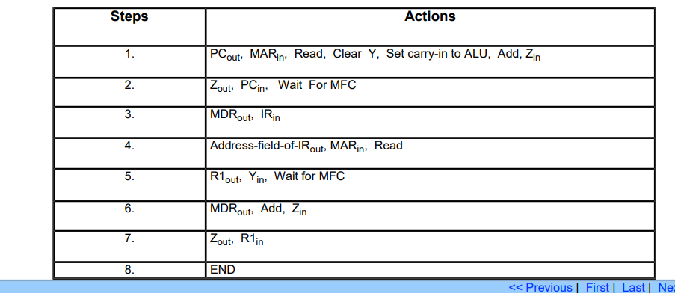

Slide 7
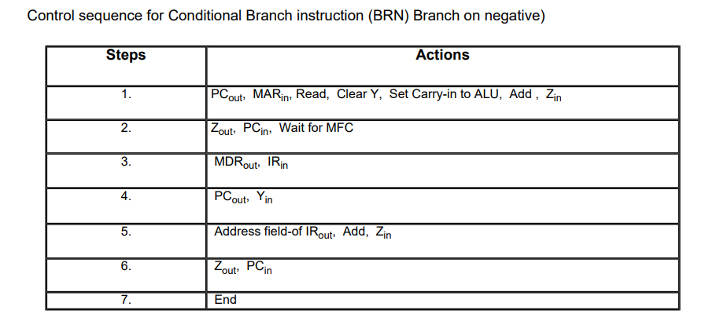

Slide 8
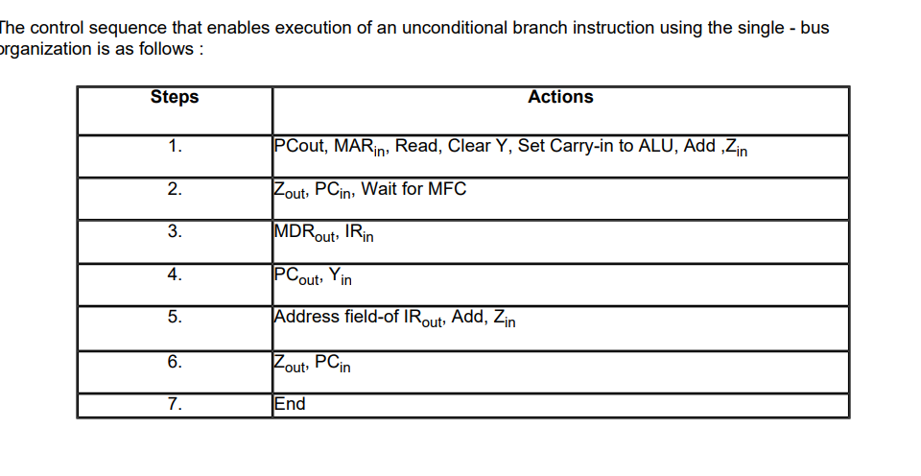

Slide 9
In case of horizontal organization, the size of control word is longer, which is in one extreme point and in case of vertical organization, the size of control word is smaller, which is in other extreme.
First consider the control signal required for fetch instruction , which is same for all the instruction, we are listing them in a particular order.

Slide 10
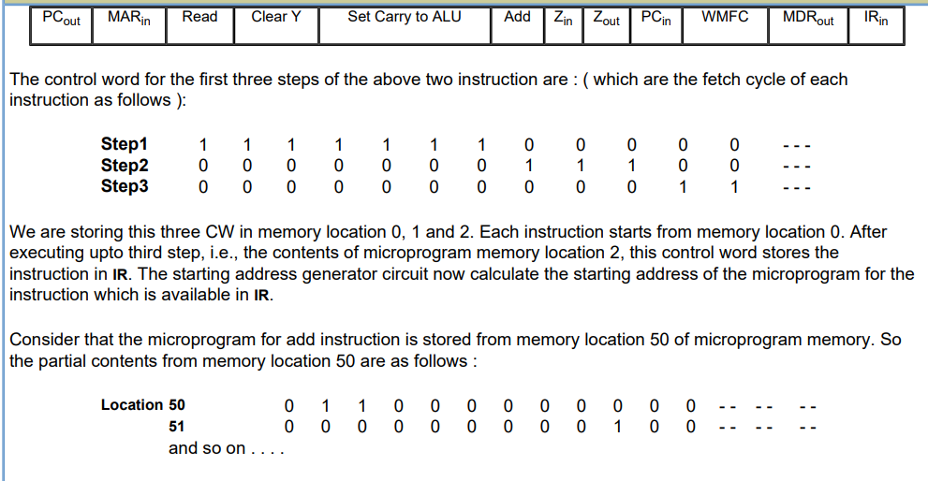

Slide 11
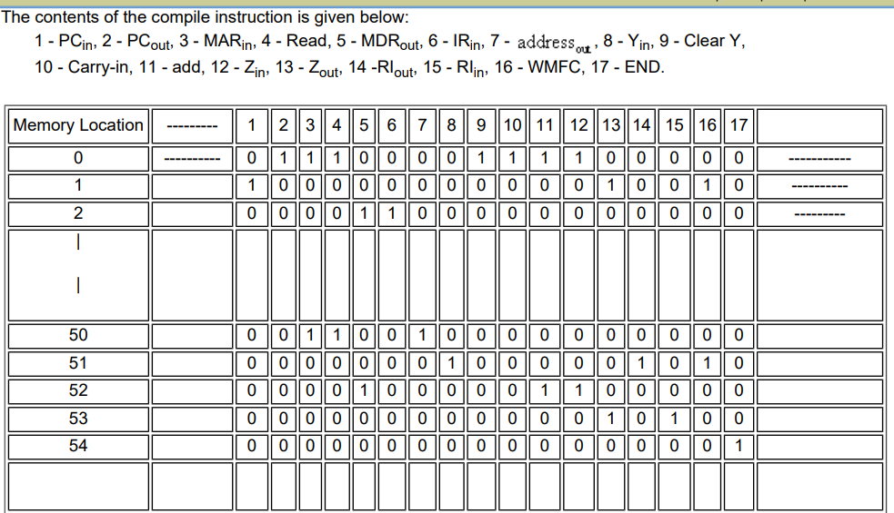

Slide 12
Grouping of control signals: It is observed that we need to store the information of each control signal in control store. The status of a particular control signal is either high or low at a particular instant of time. It is possible to reserve one bit position for each control signal.
If there are n control signals in a CPU, them the length of each control signal is n . Since we have one bit for each control signal, so a large number of resources can be controlled with a single microinstruction.
This organization of microinstruction is known as horizontal organization. If the machine structure allows parallel uses of a number of resources, then horizontal organization has got advantage.
Since more number of resources can be accessed parallel, the operating speed is also more in such organization. In this situation, horizontal organization of control store has got advantage.

Slide 13
In case of horizontal organization, the implementation is simple, but in case of vertical organization, implementation complexity increases due to the required decoder circuits. Also the complexity of decoder depends on the level of grouping and encoding of the control signal.
Horizontal and Vertical organization represent the two organizational extremes in microprogrammed control. Many intermediate schemes are also possible, where the degree of encoding is a design parameter. We will explain the grouping of control signal with the help of an example.

Slide 14
Grouping of control signals depends on the internal organization of CPU. Assigning individual bits to each control signal is certain to lead to long microinstruction, since the number of required control signals is normally large.
However, only a few bits are set to 1 and therefore used for active gating in any given microinstructions. This obviously results in low utilization of the available bit space.
If we group the control signal in some non-over lapping group then the size of control word reduces.

Slide 15
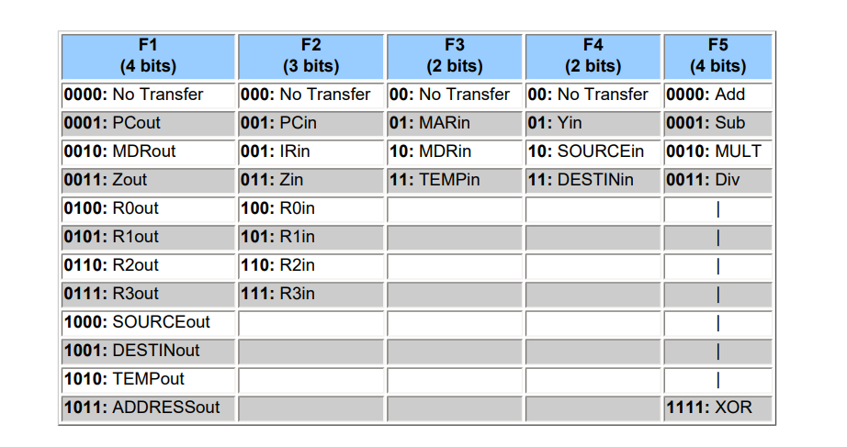

Slide 16
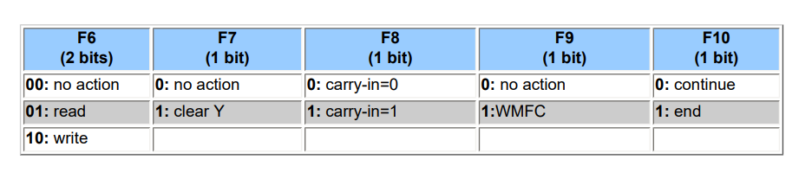

Slide 17
In this grouping, 46 control signals are grouped into 10 different groups ( F1 , F2 ,………., F10 ) and the size of control word is 21.
So, the size of control word is reduced from 46 to 21, which is more than 50%. For the proper decoding, we need the following decoder:
For group F1 & F5 : 4 X 16 decoder,
group F2 : 3 X 8 decoder
group F3,F4 & F6 : 2 X 4 decoder

Slide 18


